Slide 1
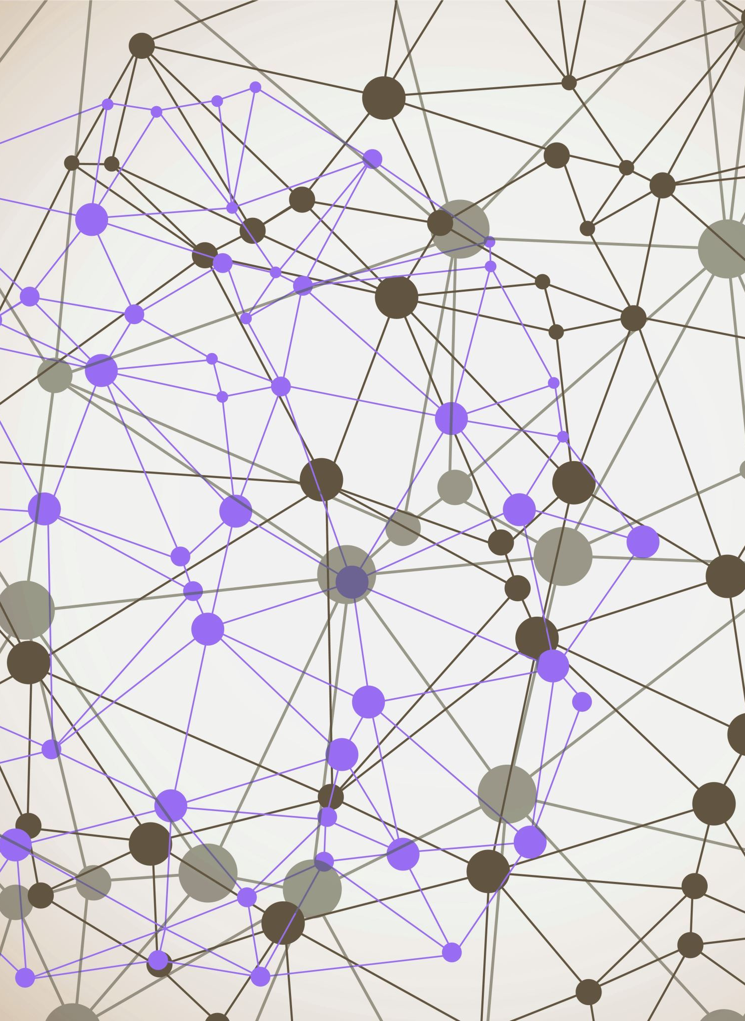
AIProbe
Rahil Mehta

Slide 2
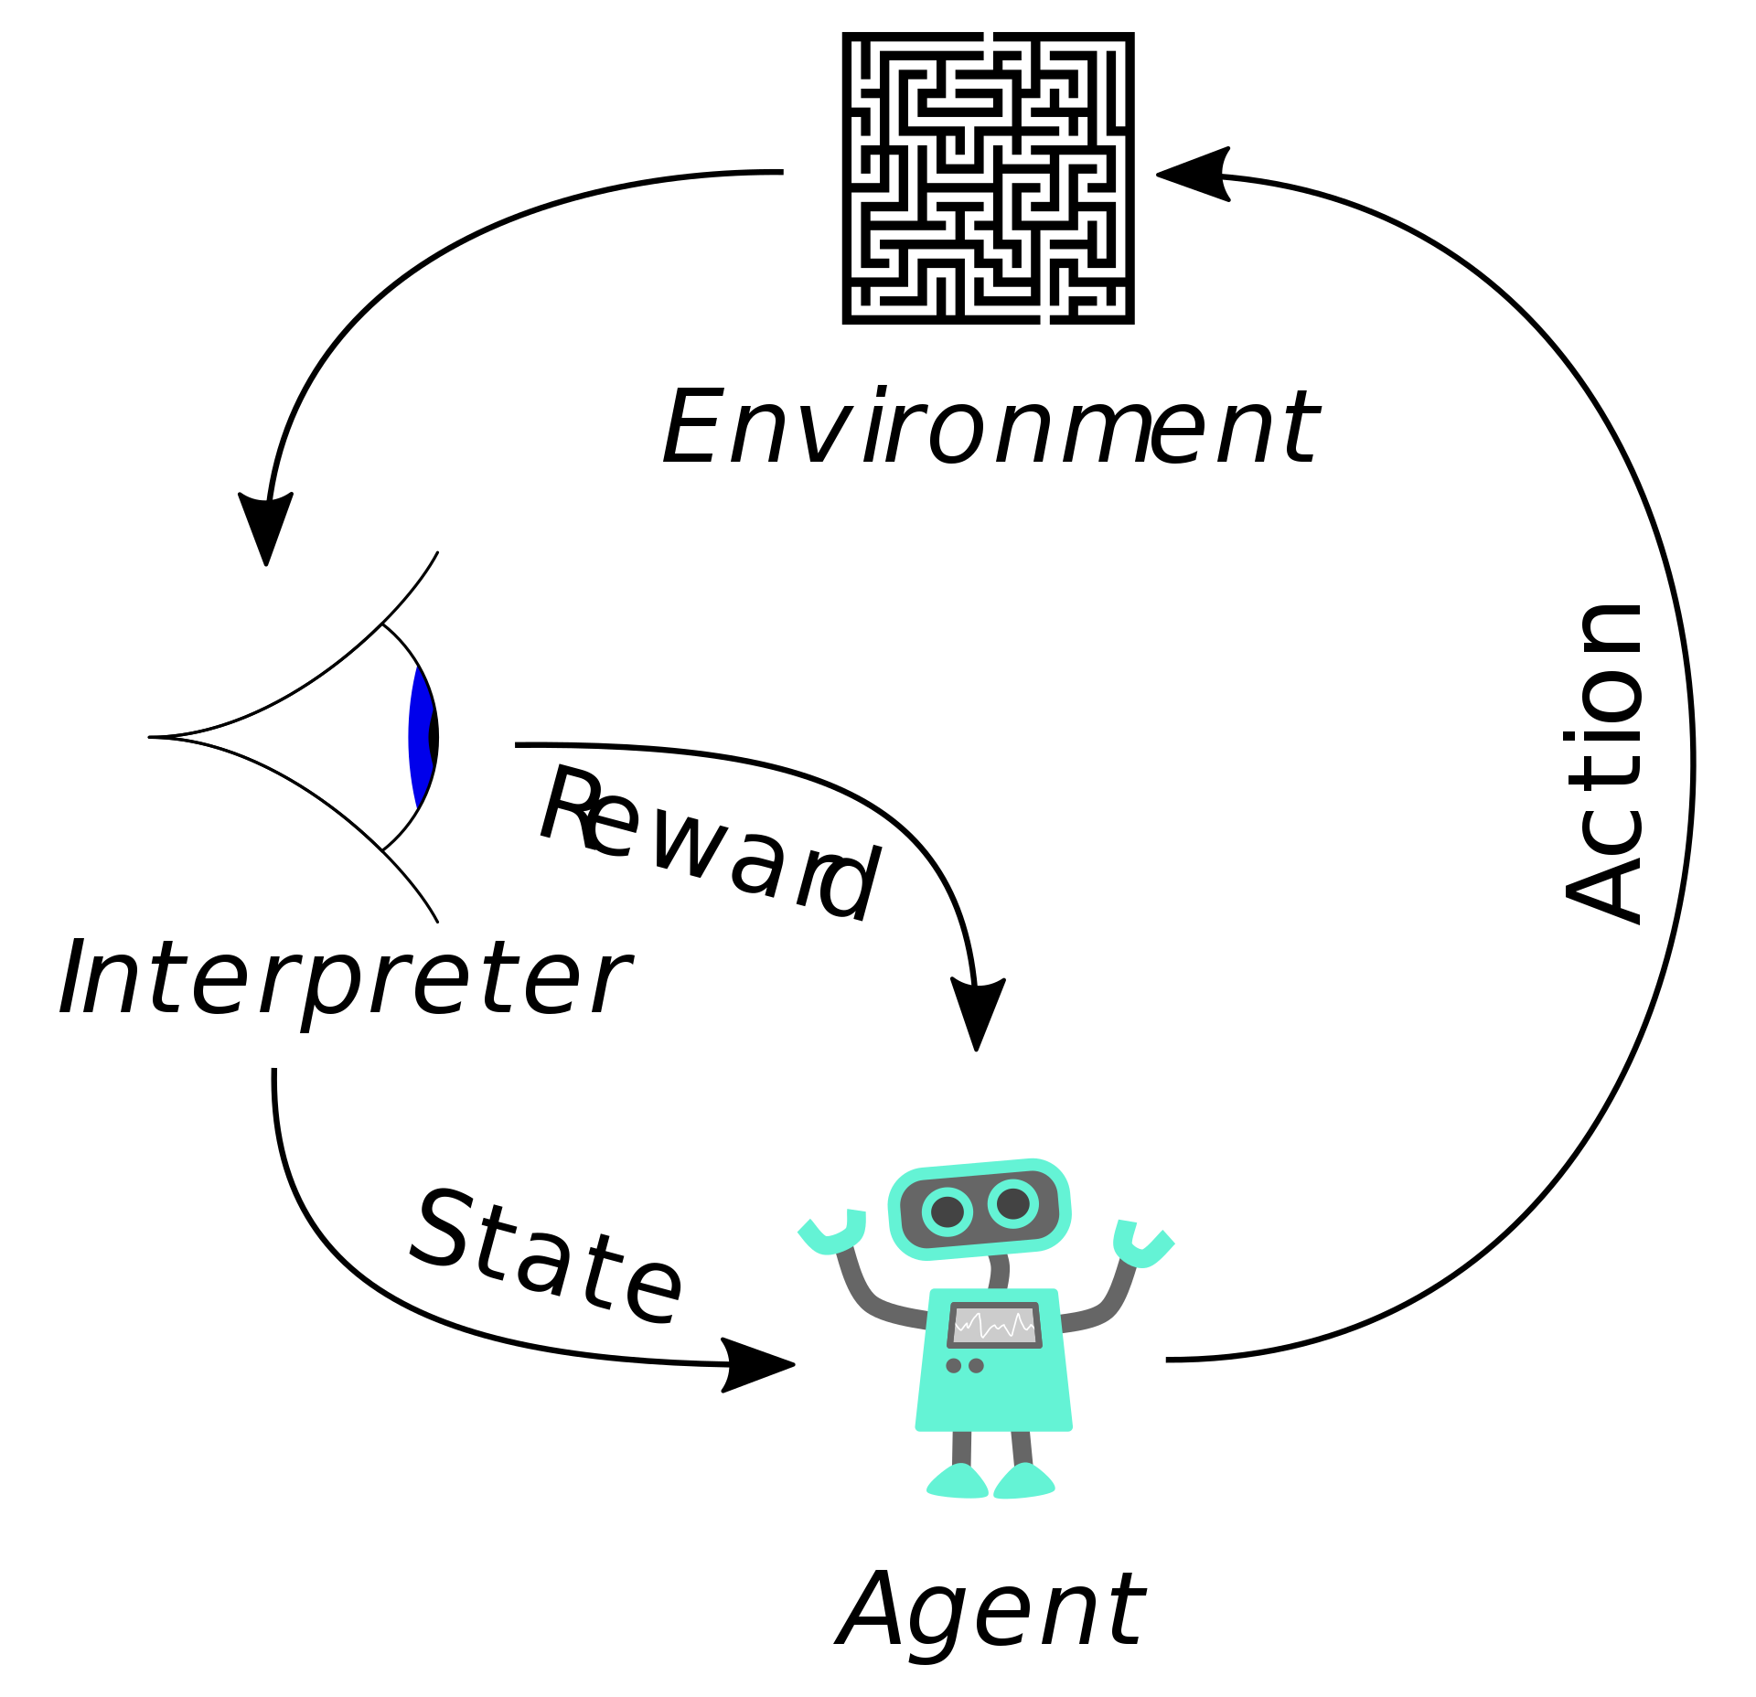
Reinforcement learning
Reinforcement Learning (RL) is a branch of machine learning where an agent learns to make decisions by interacting with an environment. The agent performs actions and receives rewards or penalties, using these experiences to learn optimal behaviors over time.

Slide 3
RL Testing
Successful
Task
AI Agent
Action
Environment
Achievable
Unsuccessful
Not Achievable

Slide 4
Proposed Solution
Environment State Utilization:
Utilize the 'Environment State' to represent both the initial and final states of the environment post-instruction execution
Capability Assessment:
The difference between the initial and final states of the environment is used to evaluate the tasks achievability from the given action space.
Fuzzer
Environment
Final State
Capability
Initial State

Slide 5
Research Question
Can a fuzzer be employed to not only generate actionable instructions but also help identify tasks that are achievable and not achievable by an AI agent, thereby identifying bugs or limitations in the AI environment?

Slide 6
Evaluation Dataset & Metrics
Dataset
Minigrid Enviroment
Metrics
Coverage
Actionability
Diversity
Consistency

